Slide 1
Pre Calculus 11
Prerequisite Lesson 0.2
Multiplying Polynomials and Basic Factoring
FOIL/Expansion
Simplifying Expressions With Liketerms
© Copyright all rights reserved to Homework depot: www.BCMath.ca

Slide 2
I) Combining Like-Terms
You can only add or subtract two terms if they are liketerms
Liketerms: Two algebraic terms that have the same variables and the exponents of the corresponding variables are the same
If they are not liketerms, then you can not add or subtract them
Ex: Indicate which of the following terms are liketerms. If they are liketerms, combine them:
Not Liketerms b/c the exponents for “x” are different
Not Liketerms b/c they don’t have the same variables
Yes they are liketerms
8x and 13x are liketerms, 11x² and -2x² are also liketerms

Slide 3
II) DO You REMEMBER HOW TO FOIL?
When multiplying two binomials, use each binomial to form the sides of a rectangle
Expand to find the area
Another method for multiplying two binomials is by using FOIL
First
Outside
Inside
Last

Slide 4
Practice: Expand the binomials
©Copyright All Rights Reserved to Homework Depot at www.BCMath.ca

Slide 5
Expand the following:

Slide 6
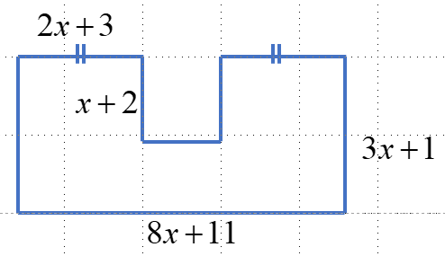
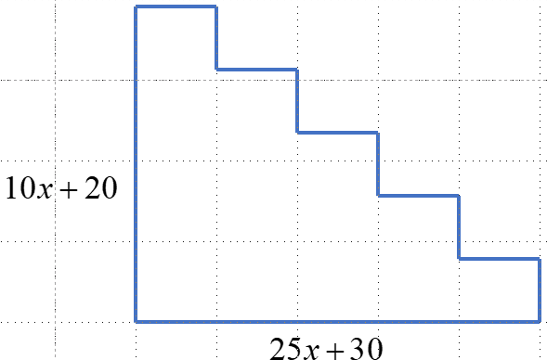
Find the Perimeter and Area of the following:

Slide 7
Ex: Given the dimensions of the solids, find an algebraic expression for the area and PERIMETER!!:

Slide 8
Find the missing side of the Right Triangle in terms of “x”

Slide 9
Basic Factoring:
Factoring is the opposite of expanding
When factoring, you are dividing out the greatest common factor between several terms
Ex: First indicate the GCF and then Factor out the GCF for each of the following
Both terms are multiples of 3
All three terms of multiples of 2
Both terms have one x variable
All three terms have a “y” variable

Slide 10
Ex: Find the Greatest common factor and then factor out the GCF for each of the following:

Slide 11
Factoring Difference of Squares:
Two binomials are conjugates if they have the same terms but a different sign in between them:
Q: What happens when you multiply a binomial with its conjugate?
1. The middle two terms will always cancel each other out
2. The first and last terms are always perfect squares
3. The middle sign is always a subtraction
Ex: Find the Conjugate:

Slide 12
Ex: Indicate what the missing terms are:

Slide 13
Factoring a Difference of Squares
When you have two perfect squares subtracting each other, you can factor it to a product of two conjugate binomials
If the two perfect squares have a common factor, you can factor out the common factor first and then separate it as a product of conjugate binomials
Ex: Factor completely

Slide 14
Ex: Factor and Simplify each of the following

